Slide 1
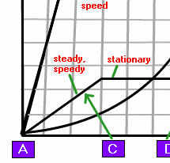
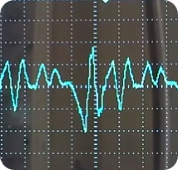
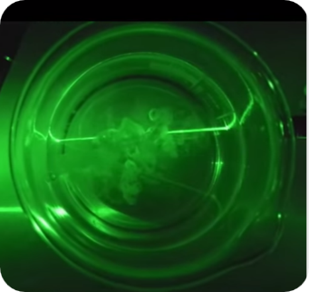
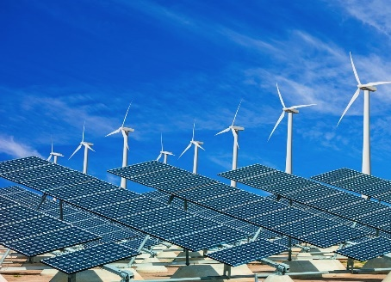
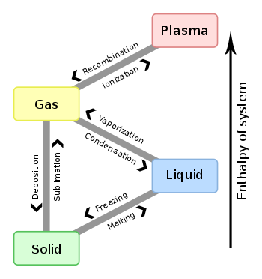
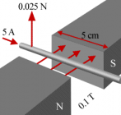
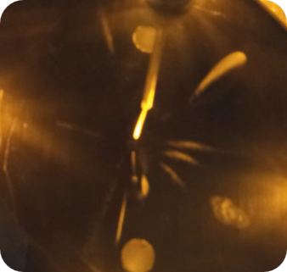
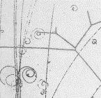
6 Magnetism and Electromagnetism
“Part D – Induction”
1 Forces and Motion
2 Electricity
3 Waves
4 Energy
5 Solid Liquids Gases
6 Magnetism
7 Radioactivity
8 Astrophysics
iGCSE Edexcel 1-9 – Mr Powell

Slide 2
6 “Part D – Induction”
6.15 know that a voltage is induced in a conductor or a coil when it moves through a magnetic field or when a magnetic field changes through it and describe the factors which affect the size of the induced voltage.
6.16 describe the generation of electricity by the rotation of a magnet within a coil of wire and of a coil of wire within a magnetic field and describe the factors which affect the size of the induced voltage.
----------------------
6.17P describe the structure of a transformer, and understand that a transformer changes the size of an alternating voltage by having different numbers of turns on the input and output sides (Triple)
6.18P explain the use of step-up and step-down transformers in the large scale generation and transmission of electrical energy (Triple)
6.19P know and use the relationship between input (primary) and output (secondary) voltages and the turns ratio for a transformer: (Triple)
input (primary) voltage / output (secondary) voltage = primary turns / secondary turns
V_{p} / V_{s} = n_{p} / n_{s}
6.20P know and use the relationship: (Triple)
input power = output power (for 100% efficiency).
V_{p} × I_{p} = V_{s} × I_{s}

Slide 3
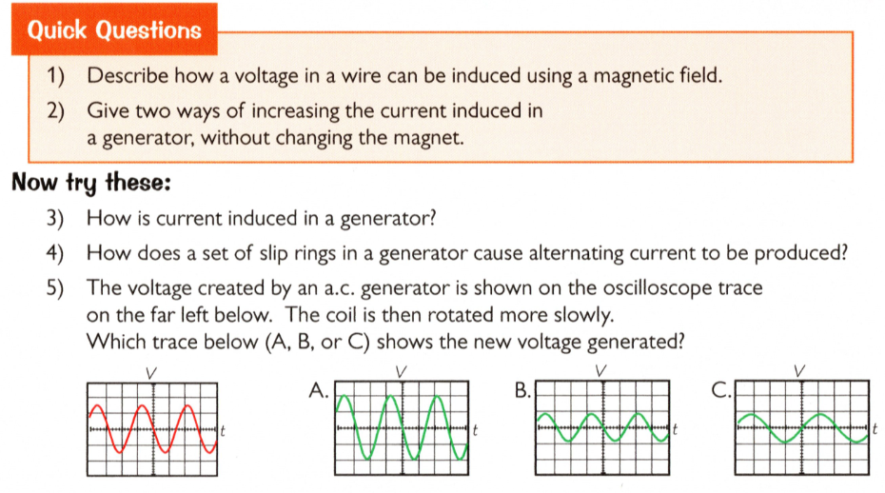
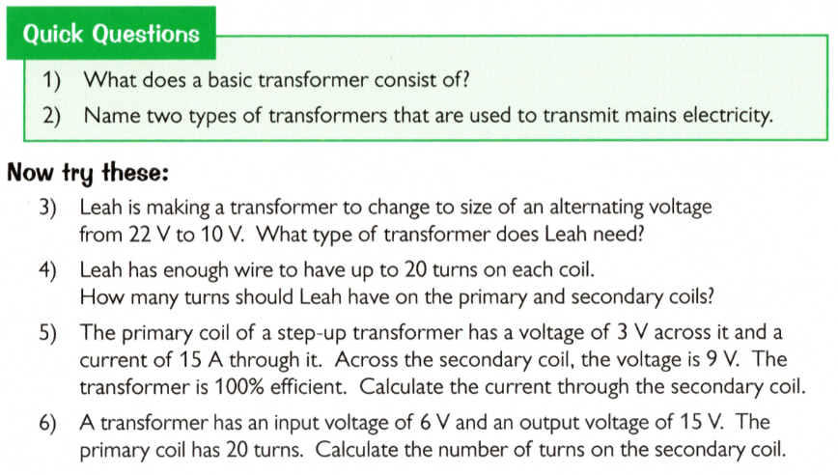
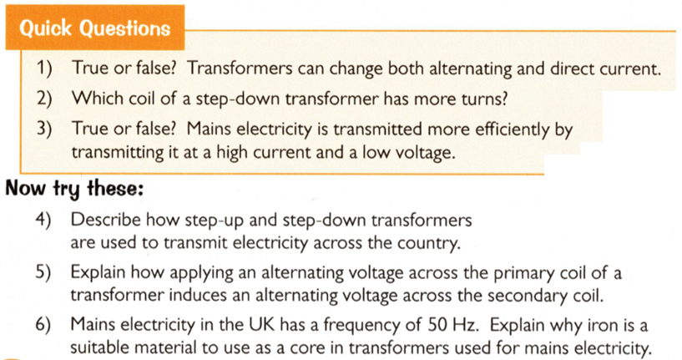
6 “Part D – Induction”
Key Topic Aims….
6.15 know that a voltage is induced in a conductor or a coil when it moves through a magnetic field or when a magnetic field changes through it and describe the factors which affect the size of the induced voltage
6.16 describe the generation of electricity by the rotation of a magnet within a coil of wire and of a coil of wire within a magnetic field and describe the factors which affect the size of the induced voltage
------------------------------------------------------------------------------
6.17P describe the structure of a transformer, and understand that a transformer changes the size of an alternating voltage by having different numbers of turns on the input and output sides (Triple)
6.18P explain the use of step-up and step-down transformers in the large scale generation and transmission of electrical energy (Triple)
6.19P know and use the relationship between input (primary) and output (secondary) voltages and the turns ratio for a transformer: (Triple)
input (primary) voltage / output (secondary) voltage = primary turns / secondary turns
V_{p} / V_{s} = n_{p} / n_{s}
6.20P know and use the relationship: (Triple)
input power = output power (for 100% efficiency).
V_{p} × I_{p} = V_{s} × I_{s}
Electromagnetic Induction
Transformers 1
Transformers 2

Slide 4
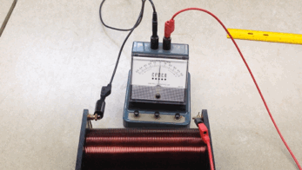
6 “Part D – Induction”
Key Topic Aims….
6.15 know that a voltage is induced in a conductor or a coil when it moves through a magnetic field or when a magnetic field changes through it and describe the factors which affect the size of the induced voltage.
6.16 describe the generation of electricity by the rotation of a magnet within a coil of wire and of a coil of wire within a magnetic field and describe the factors which affect the size of the induced voltage.
Increasing the induced voltage...
move the magnet faster
use a stronger magnet
increase the number of turns on the coil
increase the area of the coil

Slide 5

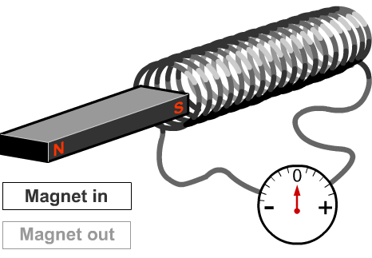
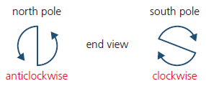
Lesson 8 The Generator Effect (1 hour)
I can describe how the current is induced in a wire when it moves in a magnetic field.
4
I can identify apparatus needed to demonstrate induced current & plot a suitable graph from data
5/6
I can identify the factors that affect the size and direction of the induced current or the potential difference and write an analysis of an induction graph
7/8
I can apply the induction rule with confidence…..
Notes:
Do Demo with Magnet in Coil of wire with light beam galvanometer

Slide 6

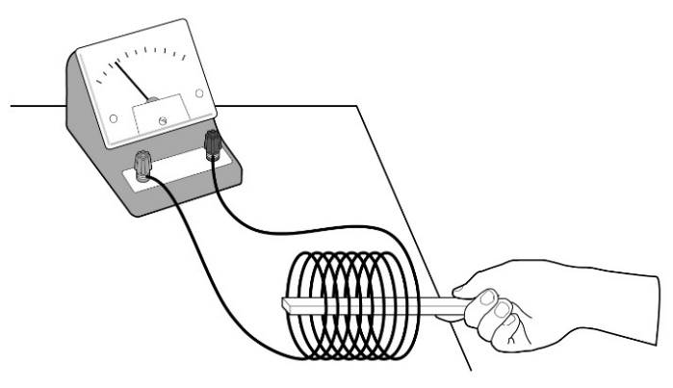
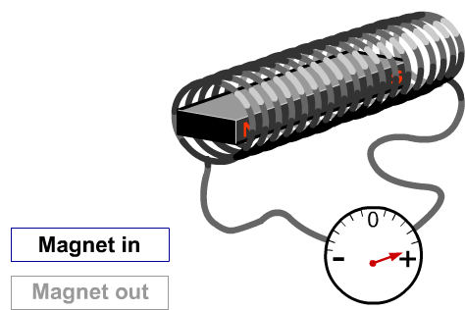
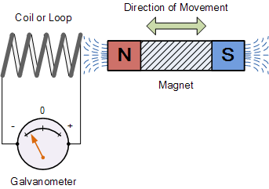
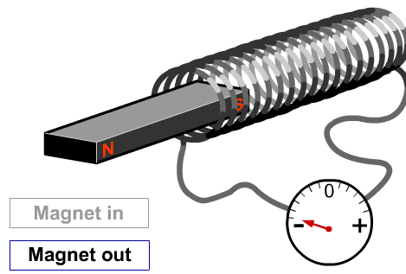
Lesson 8 – Graphical Analysis of Generator Practical Analysis Sheet
Number of turns in the coil | Potential Difference Induced /V
 | 1 | 2 | 3 | Mean
25 | 0.40 | 0.42 | 0.42
50 | 0.83 | 0.82 | 0.85
75 | 1.25 | 1.23 | 1.24
100 | 1.60 | 2.05 | 1.61
125 | 2.02 | 2.06 | 2.03
150 | 2.42 | 2.41 | 2.40
175 | 2.83 | 2.84 | 2.84
200 | 3.20 | 3.20 | 3.20
A student conducted an experiment on the motor effect. They moved a magnet through a coil of wire with a different number of turns and measured the voltage produced. The student did each experiment three times and found a mean so they could exclude an anomalous reading. Work through the sheet and conduct your own analysis of the results…
Give one reason that the student repeated the experiment.
Data Questions…
There is one anomalous result in the table. Circle it.
When calculating the mean, what do you do with the anomalous result?
How many significant figures is the mean voltage going to have and why?
Calculate the mean for each result.
Graph Questions…
Plot a graph of voltage against number of turns in the coil. Extend the x-axis to go up to 250 turns in the coil.
What happens to the voltage as the number of turns in the coil increases?
Use the graph to predict the voltage produced if the coil had 160 turns in it?
Use the graph to predict the number of turns needed to generate 3.50 V. ?
Give three variables that the student would have to keep the same for the results to be valid.
Rule to learn is.....
North pole - aNticlockwise
South pole – Clockwise
http://phet.colorado.edu/en/simulation/faraday

Slide 7
Lesson 8 - Graphical Analysis of Generator Effect worksheet
Number of turns in the coil | Potential Difference Induced /V
 | 1 | 2 | 3 | Mean
25 | 0.40 | 0.42 | 0.42 | 0.41
50 | 0.83 | 0.82 | 0.85 | 0.83
75 | 1.25 | 1.23 | 1.24 | 1.24
100 | 1.60 | 2.05 | 1.61 | 1.61
125 | 2.02 | 2.06 | 2.03 | 2.04
150 | 2.42 | 2.41 | 2.40 | 2.41
175 | 2.83 | 2.84 | 2.84 | 2.84
200 | 3.20 | 3.20 | 3.20 | 3.20

Slide 8
Lesson 8 - Graphical Analysis of Generator Effect worksheet

Slide 9
Lesson 8 - Graphical Analysis of Generator Effect worksheet
1) The student repeated their results to see if their results were accurate. If they were all close together, we could consider the results to be precise.
2) The anomalous result is 2.05V, produced with 100 turns in the coil.
3) You do not use the anomalous result to calculate the mean.
4) The mean voltage is meant to have the same number of significant figures as the measured voltages. This is because the equipment cannot measure any more significant figures and so any more significant figures would be meaningless.
5/6) see line graph example
7) As the number of turns in the coil increases, the voltage increases.
8) 2.48–2.56V
9) 215–220 turns
10) The student needed to keep the following things the same:
the strength of the magnet
the speed they put the magnet in
the coil
the area of the coil.

Slide 10
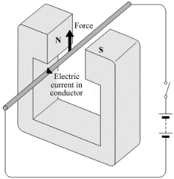
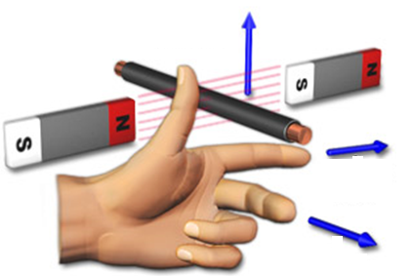

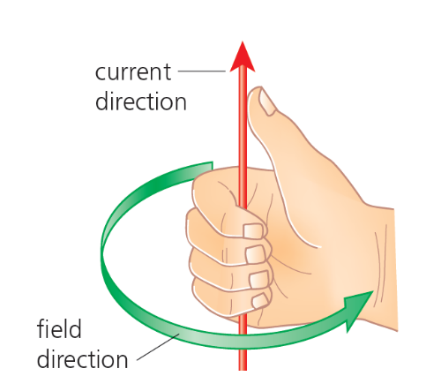
Learning Flemings Left-hand Rule
The magnetic field produced around the wire due to the current flow interacts with the field across the jaws of the horseshoe magnet.
It pushes the wire out of the field according to the “Left Hand Rule”. Which is very easy to remember using the mnemonic of FBI.
If all three are at 90° you get a maximum force or push. This is sometimes called the “motor effect” or a catapult field.
F = Force (N)
B = Magnetic Field “Flux Density” (T)
I = Conventional Current Flow (A)
Direction of Force (N)
Magnetic Flux Density (B)
Don’t Shoot!
Conventional Current (I) + to -

Slide 11
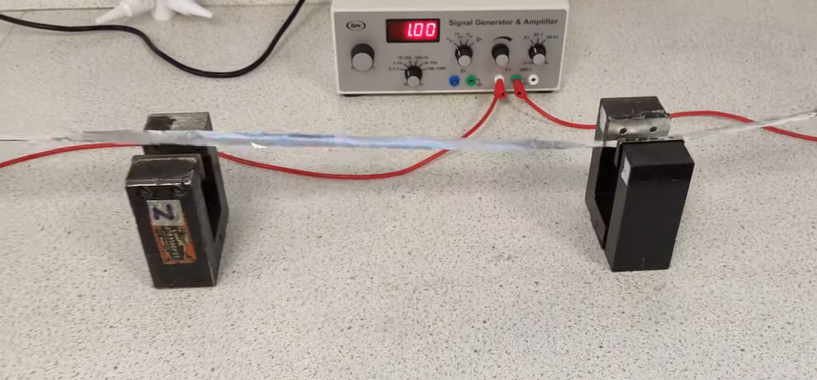
Learning Flemings Left-hand Rule
https://youtu.be/AJrBOPjoVbo
Direction of Force (N)
The aluminium acts as a conductor
The AC signal means it reverses flow after a half cycle
The magnets have different polarity to oppose the motion.
Magnetic Flux Density (B)
Conventional Current (I) + to -

Slide 12
Complex View of why it goes left or right!
N
If you cannot remember the rule you can work out the situations from the first principles of conflicting magnetic fields and the right hand grip rule.
The diagrams clearly show how on one side the fields cancel and on the other they add. This addition creates a motion left or right (on the diagrams).
Try using the LHR and RH Grip rule to work it out…
S
B out of the page
N
Direction of Force (N)
x
Magnetic Flux Density (B)
Conventional Current (I) + to -
S
B in of the page
https://youtu.be/U9RezsWnPYs

Slide 13
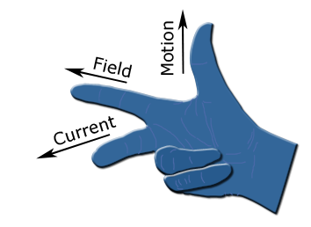
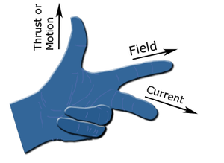
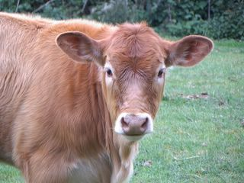
Flemings Left Hand Rule - Motors
Flemings Right Hand Rule - Generators
When a flow of electrons moves along a wire the interaction of two fields produces an overall force to one side.
We have magnetism and electricity and produce…. motion.
When we pull a wire in a magnetic field ourselves (adding to the kinetic energy store) the motion and force interact to induce a flow of current and a potential difference across the wire. Connected to a circuit it produces a current.
We have magnetism and motion and produce…. electricity
Wire forced up
S
B
I
S
Pull the wire
I
B
N
N
N
+ Potential Diff -
S
https://youtu.be/GmURfG3tAhg

Slide 14
Lesson 8 The Generator Effect - Summary
When a wire is held stationary between the poles of a magnet there is no current in the wire. If the wire moves it cuts the magnetic field lines. A potential difference is induced across the ends of the wire and if the wire is part of a complete circuit an induced current passes along the wire. This is called the generator effect. A potential difference is also induced whenever a magnetic field changes.
The induced potential difference can be increased by;
moving the wire or magnet faster
using a stronger magnetic flux density
replacing the wire with a coil of many loops.
The direction of the induced potential difference is always such as to oppose the motion or change producing. You can think of this like a resistance idea which conserves energy. If not when I pushed a magnet into a coil of wire if the field induced was in the same direction we would have free energy, it has to be in the opposite direction.
A magnet pushed into a coil of wire will produce a push or electrons clockwise or anticlockwise.
S
Pull the wire
I
B
N
+ Potential Diff -
Pull the wire
S
I
B
N
A

Slide 15
Lesson 8 The Generator Effect – Review Questions…
Answers..
By changing the magnetic field – either by varying the strength of the magnets or by moving the wire relative to the magnets.
0 V – since the magnetic field doesn’t change.
You can move the magnet more slowly, use a weaker magnet with a lower flux density or use a solenoid with fewer turns.
There would not be a complete circuit so no current flows. Therefore, the meter would always be pointing to 0 A.
1 How can a potential difference be induced in a wire in a magnetic field?
2 What is the value of the induced potential difference when the wire Is moved parallel to the magnetic field?
3 A bar magnet is moved quickly into a solenoid. Explain how you can reduce the size of the induced potential difference.
4 Suggest what you would see if only one end of the meter was connected to the coil.
Pull the wire
S
I
B
N
+ Potential Diff -

Slide 16
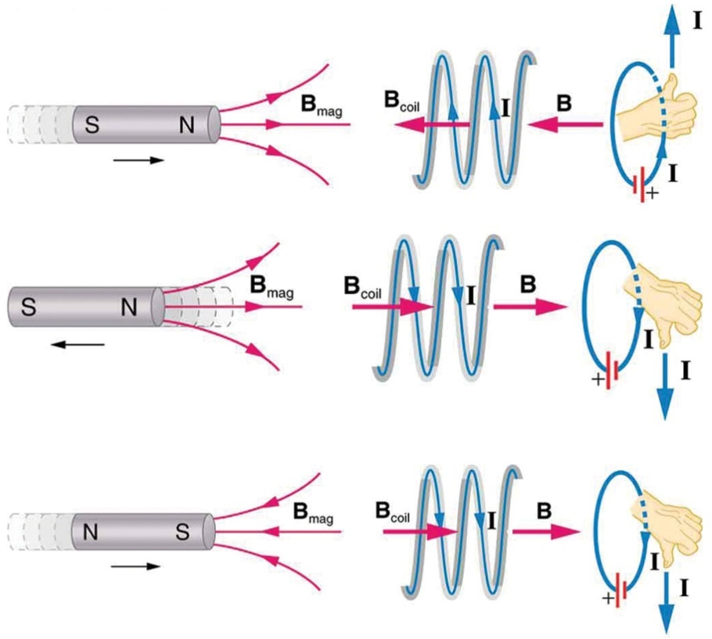
Direction of Fields – Using the Right Hand Grip (Extension)
Usually you will not need to know the direction as they will give you a first example and ask you what is the direction after a reversal of the field. However, these diagrams may help you.
Rule to learn is.....
  North pole - aNticlockwise
  South pole – Clockwise

Slide 17
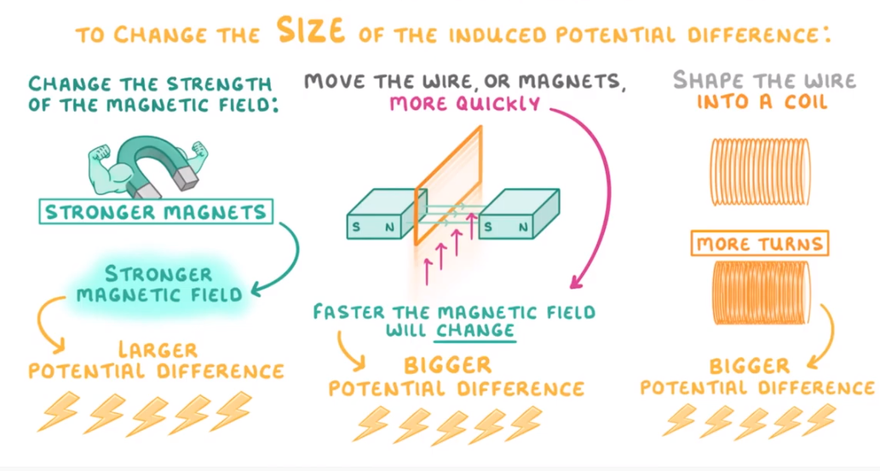
Cognito – Review – Induced Potential Difference
https://youtu.be/pkzY7QfTowM
Task…
Review the lesson contents and the videos, make some notes on the key ideas.

Slide 18
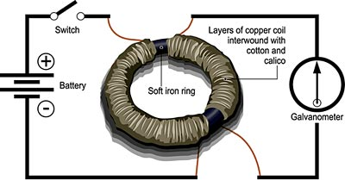
Lesson 9 Key concept: The link between electricity and magnetism
I can explore how electricity and magnetism are connected.
4
I can describe how electromagnetic induction occurs.
5/6
I can describe the principle of the electric motor.
7/8
I can explain how faradays ring works, and current is created only when using AC potential difference or a changing DC current.
Notes:
Faraday’s Induction Ring
This experiment was the basis for Faraday’s Law where a current is induced when there is a changing magnetic field.
Battery pack (DC supply)
Coated wire on laminated core
Entre zero ammeter
Leads and crocodile clips

Slide 19
Ken Campbell - Faraday's Doughnut – 24 mins
Liquid Mercury
Frogs Legs
Watch the three videos about Michael Faradays invention of the Motor.
How do all these ideas fit together. Try and answer these quick questions below?
Pb & Acid
Metal Ring
Electromagnetism?
Coil A and Coil B
When was Michael Faraday born?
What did Faraday have as a first job?
What was the news from Italy?
Where did the electricity come from?
What did this idea lead to?
Who lectured Physics and inspired Faraday at the Royal Institution?
How did he get his job?
What happened to the needle when he passed the current through?
What type of force was it?
Explain what happened with the mercury bath?
Part 1 - vUuTMF811qw
Part 2 - QT6EtgPpSTs
Part 3 - mZrvnvAoB7E

Slide 20
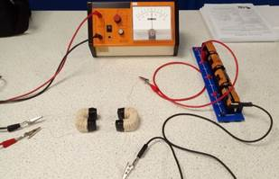
Faraday Demonstration
Faraday’s Induction Ring
This experiment was the basis for Faraday’s Law where a current is induced when there is a changing magnetic field.
Battery pack (DC supply)
AC Supply
Coated wire on laminated core
Entre zero ammeter
Leads and crocodile clips

Slide 21
Michael Faraday “Historical” Video Quick Questions (24 mins) (Self assess)
When was Michael Faraday born? | 1791
What did Faraday have as a first job? | A book binder
What was the news from Italy? | Artificial electricity – frogs legs – Batteries “Galvani”
Where did the electricity come from? | Two wires “volta” worked it out
What did this idea lead to? | “Batteries”
Who lectured Physics and inspired Faraday at the Royal Institution? | Humphrey Davy one of the senior Scientists of the day
How did he get his job? | Made a book of Davy’s notes to impress him
What happened to the needle when he passed the current through? | It twisted and moved to one side when the motion was one way, and opposite when it was the other.
What type of force was it? | Circular around the wire
Explain what happened with the mercury bath | A battery was connected to a circuit with fluid mercury to complete the circuit. Electrons flowed through the mercury and the wires. Using the right-hand grip rule, we can see the force was circular and the current flow up or down the wire.

Slide 22
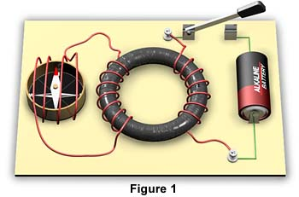
Faraday Law - Summary
Faraday made his discovery of electromagnetic induction with an experiment using two coils of wire wound around opposite sides of a ring of soft iron.
The first coil is attached to a cell or battery.
The second coil contains a compass, which acts as a galvanometer to detect current flow.
When the switch is closed, a current passes through the first coil and the iron ring becomes magnetised.
When the switch is first closed, the compass in the second coil deflects momentarily and returns immediately to its original position.
The deflection of the compass is an indication that an electromotive force was induced causing current to flow momentarily in the second coil.
Final Ideas...
He hypothesised that a changing magnetic field induces a current in the second coil.
The closing and opening of the switch cause a magnetic field to change: to expand and collapse respectively.
There is no deflection when the circuit is on normally

Slide 23
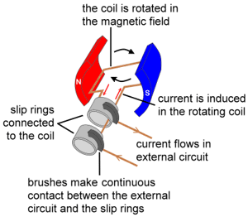
Lesson 10 Using the generator effect to make a “generator”
I can explain how moving coil microphones use the generator effect.
4
I can explain how a dynamo generates direct current and an alternator generates alternating current.
https://youtu.be/ATFqX2Cl3-w
5/6
I can for a dynamo and an alternator, draw and interpret graphs of potential difference generated in the coil against time.
7/8
I can explain in detail the difference between AC and DC without help.

Slide 24
Lesson 10 Using the generator effect to make a “generator”
The Syllabus aim for this section is…
6.16 describe the generation of electricity by the rotation of a magnet within a coil of wire and of a coil of wire within a magnetic field and describe the factors which affect the size of the induced voltage.
Task…
Use the resources provided to make your own notes and draw suitable diagrams that show this idea.
You should include ideas for both the D.C. and A.C. generator using the right hand rule.
Also a clear explanation how the two types of commutator work.
If able to try and explain why the angle the coil is at makes a difference?
Answer the spaced learning questions.

Slide 25
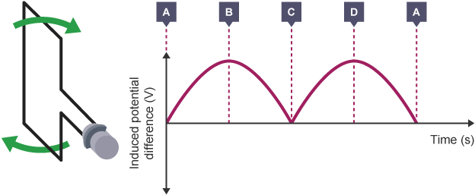
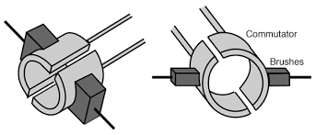
DC Generator or Dynamo – Right hand rule!
S
Dynamo is an older term used to describe a generator that makes direct current power. DC power sends electrons in only one direction. The problem with a simple generator is that when the rotor rotates it eventually turns completely around, reversing the current. To get around this they invented something called a split ring commutator.
The commutator is a like a switch that allows current to only flow in one direction. Each time the coil of wire is pushed around the field it allows the force to stay up on one side and down on the other all the time.
However, it does not provide a steady or constant current… direct current as the angle of the coil to the field changes
F
N
F
N
S
F
X
F
Right-Hand Rule!

Slide 26
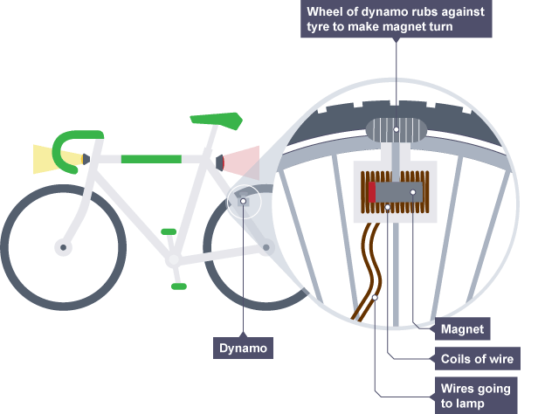
The Dynamo (Extra on Formula)
The output of a dynamo can be shown on a voltage–time graph. The graph shows a sine curve that stays in the same direction all the time. The maximum potential difference or current can be increased by:
increasing the rate of rotation (F)
increasing the strength of the magnetic flux density (B)
increasing the number of turns on the coil (L)
F = BIL

Slide 27
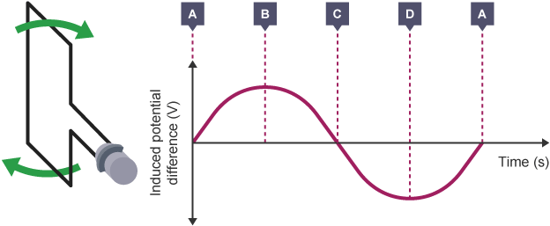
The Generator (Basics)
The generator differs from the dynamo in that it produces AC power. Electrons flow in in both directions in AC power.
It wasn't until the 1890s that engineers had figured out how to design powerful motors, transformers and other devices which could use AC power in a way that could compete with DC power.
While the alternator uses commutators, the generator uses a slip ring with brushes to tap the power off of the rotor. Attached to the slip ring are graphite or carbon "brushes" which are spring loaded to push the brush onto the ring.
This keeps power consistently flowing. Brushes get worn down over time and need to be replaced.

Slide 28
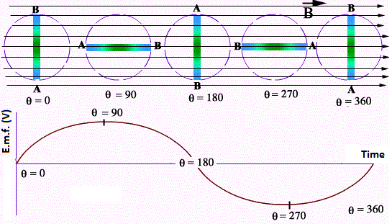
Comparison of Graphs… (Extension for A2 Physics)
Coil starts in reference position 0° (to vertical). The plane of the coil is perpendicular to the magnetic field lines. This means that the sides of the coil are moving at 90∘ to the magnetic field lines and not “cutting” through any magnetic field lines. Hence, no PD is induced.
Coil gets turned to reference position 90° The plane of the coil is parallel to the magnetic field lines. The sides of the coil are moving through the magnetic field lines (at 90° in 3D) and will be “cutting” through the magnetic field lines at the greatest rate. Hence, the induced PD is the maximum at this position. (Like scissors cutting string in 3D)
Coil gets turned to reference position 180° and 360° : Same as the analysis in reference position 0°.
Coil gets turned to reference position 270° : Same analysis as in reference position 90° BUT the PD is in the opposite direction.

Slide 29
Spaced Learning Review Question
Task 1… Answer the questions on your own – write a clear answer and number in your book. Get as far as you can in the time you have….
Electromagnetic Induction…

Slide 30
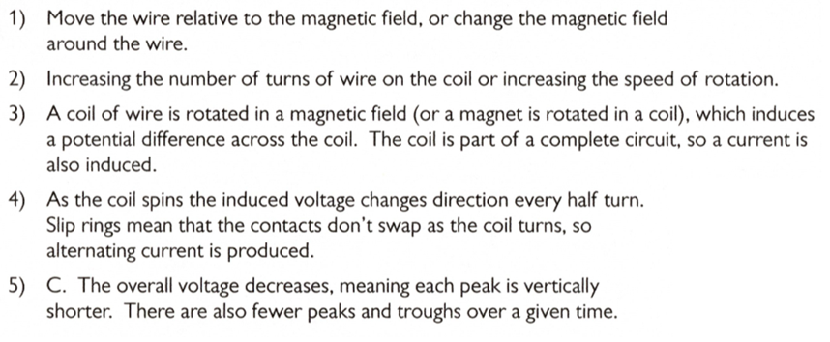
Spaced Learning Review Answers
Task 2… Mark your work in green pen, you can judge how you did, put a clear total at the bottom and put one clear comment on what you must improve on.
Electromagnetic Induction…

Slide 31
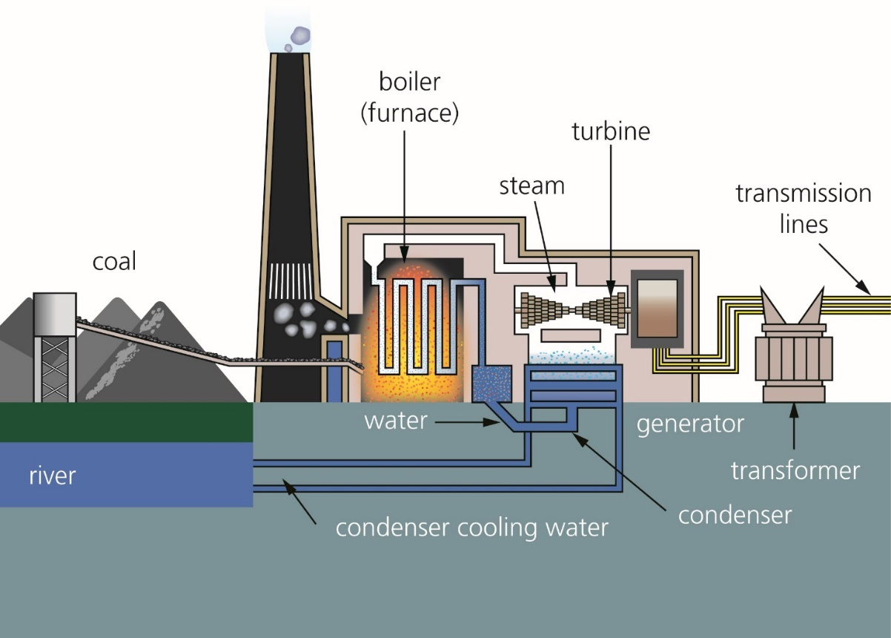
Review Task....
Look at the diagram shown, discuss with a partner….
Explain how the energy is transferred in simple terms & energy sources and stores.
Include some detail about where energy might be lost.
Explain how the generator works using prior learning.

Slide 32
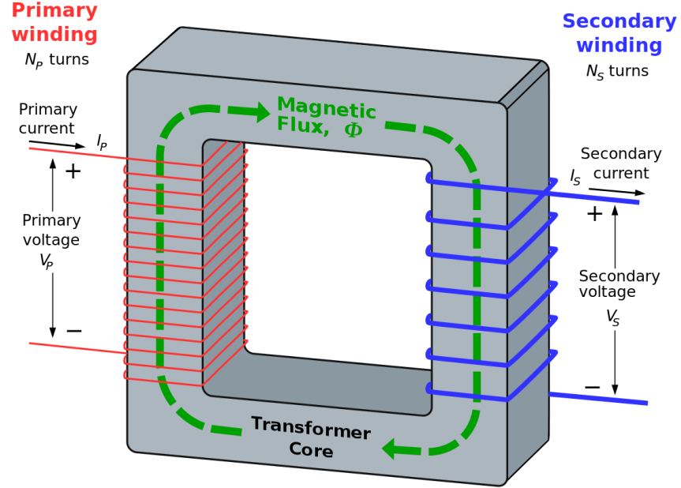
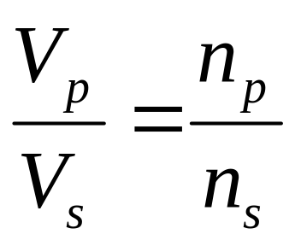
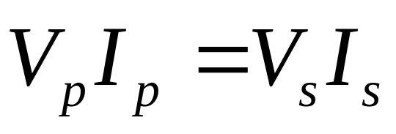
Lesson 11 Transformers (triple) (2 hours)
I can explain using the right hand grip rule how a step up or step down transformer works.
I can explain how a transformer both uses and produces alternating current
4
I can explain the relationship between the number of turns in the primary coil and the number in the secondary coil.
5/6
I can calculate the current that needs to be provided to produce a particular power output. P = VI
7/8

Slide 33
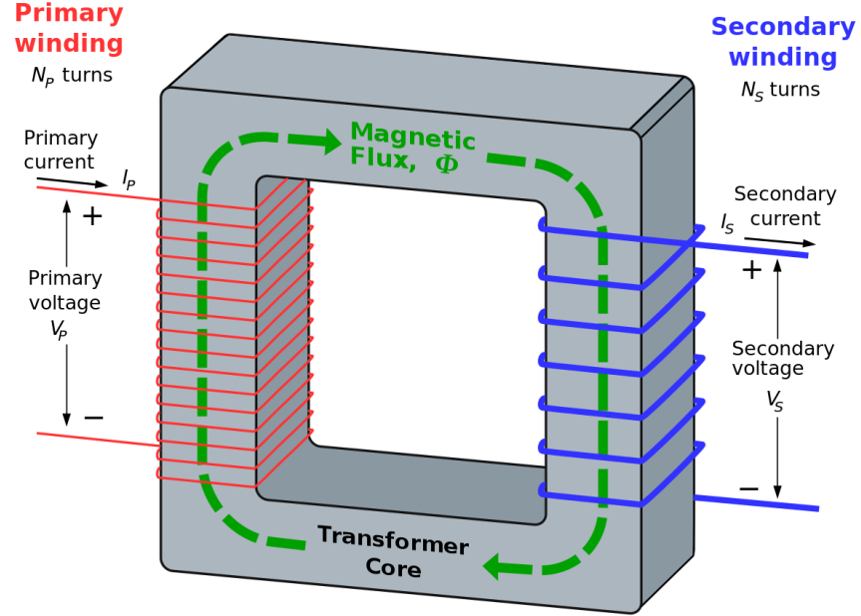
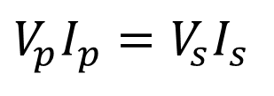
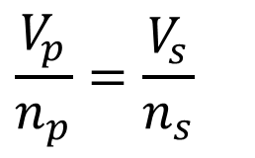
Primary and Secondary Windings
$$\frac{V_{p}}{n_{p}}=\frac{V_{s}}{n_{s}}$$
$$V_{p}I_{p}=V_{s}I_{s}$$
Always think of the idea that there are two circuits here. No current passes between them they are isolated from each other!

Slide 34

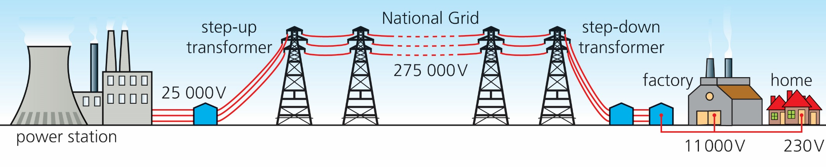
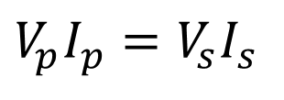
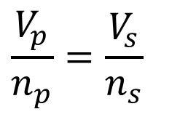
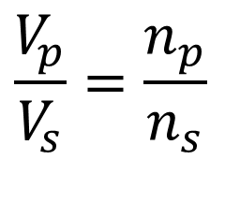
How Transformers Work 9 mins – Video – Review….
https://youtu.be/ZjwzpoCiF8A
An alternating potential difference causes the electrons to move backwards and forwards in the primary coil.
This induces changing magnetic flux in the transformer core (DONUT).
The electrons in the secondary coil of wire experience a push or pull due to the changing magnetic flux.
The windings are produced in a ratio to either step-up (more coils) or step-down the potential difference on the secondary (less coils)
We do this to reduce power losses in transmission lines
$$\frac{V_{p}}{V_{s}}=\frac{n_{p}}{n_{s}}$$
$$\frac{V_{p}}{n_{p}}=\frac{V_{s}}{n_{s}}$$
$$V_{p}I_{p}=V_{s}I_{s}$$
P_{loss}= I²R

Slide 35
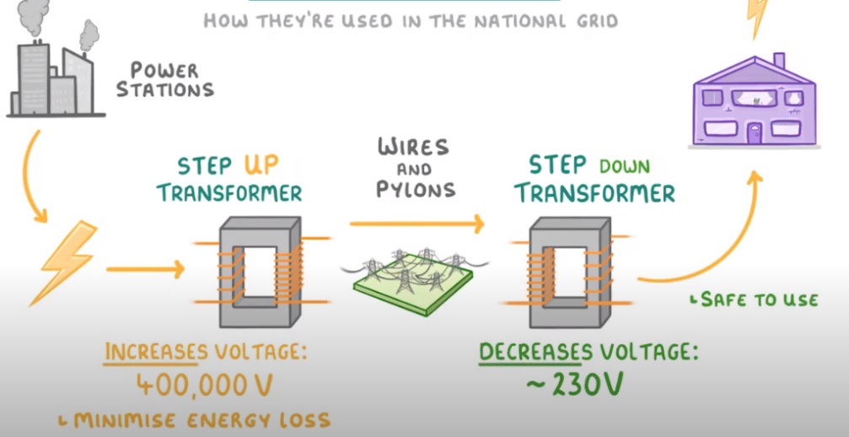
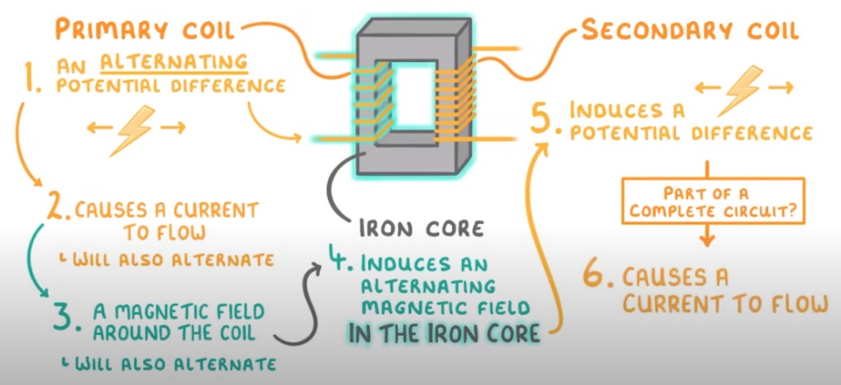



GCSE Physics – Cognito Video…
https://youtu.be/7RtBUEZbKmI
Task…
Watch this video
Make some notes on the key ideas?
Then practice using the formulae
$$\frac{V_{p}}{V_{s}}=\frac{n_{p}}{n_{s}}$$
$$V_{p}I_{p}=V_{s}I_{s}$$

Slide 36
Lesson 11 Transformers – Worksheet 1
Would you use a step-up or a step-down transformer to:
  Change 25kV to 400 kV
  Change 240V from a mains socket to 19V to charge a laptop?
Why can't you use a transformer to change the potential difference of a battery?
Explain how induction Is used in a transformer.
To change 240V a.c. to 12V a.c., how many turns should there be on the secondary if there are 720 turns on the primary coil?
To change 240V a.c. to 20V, how many turns should there be on the primary coil if there are 100 turns on the secondary coil?
If you fed 240V a.c. into a 100 turn primary coil and had 10 turns on the secondary coil, what would the potential difference across the secondary coil be?
If the output of a laptop charger Is 19V and 3.4A and the charger runs from 240V a.c. how much current does it draw?
If a 3 kV generator fed 20A into a step-up trans-former to run a power distribution system at 60 kV, the current output would only be 1A. At lower current levels the energy losses from the power lines are much less and so the power would be distributed much more efficiently.
  Show that the current output would be 1A.
  If the step up transformer has 500 turns on the primary coil, how many turns must be on the secondary?
P_{loss}= I²R

Slide 37
Lesson 11 Transformers – Worksheet 1
Would you use a step-up or a step-down transformer to:
  Change 25kV to 400 kV
  Change 240V from a mains socket to 19V to charge a laptop?
Why can't you use a transformer to change the potential difference of a battery?
Explain how induction Is used in a transformer.
To change 240V a.c. to 12V a.c., how many turns should there be on the secondary if there are 720 turns on the primary coil?
To change 240V a.c. to 20V, how many turns should there be on the primary coil if there are 100 turns on the secondary coil?
P_{loss}= I²R

Slide 38
Lesson 11 Transformers – Worksheet 1
If you fed 240V a.c. into a 100 turn primary coil and had 10 turns on the secondary coil, what would the potential difference across the secondary coil be?
If the output of a laptop charger Is 19V and 3.4A and the charger runs from 240V a.c. how much current does it draw?
If a 3 kV generator fed 20A into a step-up trans-former to run a power distribution system at 60 kV, the current output would only be 1A. At lower current levels the energy losses from the power lines are much less and so the power would be distributed much more efficiently.
  Show that the current output would be 1A.
  If the step up transformer has 500 turns on the primary coil, how many turns must be on the secondary?
P_{loss}= I²R

Slide 39
Lesson 11 Transformers – Questions - Answers
1a Step up 1b Step down
2 Transformers need an alternating potential difference to work. A battery is d.c.
3 The magnetic field in the iron core is changing. So the secondary coil is in a changing magnetic field which means there is a p.d. induced in the secondary coil due to the generator effect. The AC current induces an alternating magnetic field which induces a transformed AC current in the secondary coil.
4 V_{p} / V_{s} = n_{p} / n_{s}
240 / 12 = 720 / n_{s}
20 = 720 / n_{s}
n_{s} = 720 / 20
n_{s} = 36
5 V_{p} / V_{s} = n_{p} / n_{s}
    240 / 20 = n_{p} / 100
    12 = n_{p} / 100
    n_{p} = 12 × 100
    n_{p} = 1200
6 V_{p} / V_{s} = n_{p} / n_{s}
    240 / V_{s} = 100 / 10
    V_{s} = 240 / 10
    V_{s} = 24 V

Slide 40

Lesson 11 Transformers – Questions 1 0 - Answers
7 Power output = Current * Potential Diff
P = IV
P = 3.4 × 19
    P = 64.6 W
Assume the transformer is 100% efficient.
Power in = 64.6 W
So….
240 × I = 64.6
I = 64.6 / 240
I = 0.27 A (to 2 sf)
8a V_{s} × I_{s} = V_{p} × I_{p}
60 000 × I_{s} = 3000 × 20
I_{s} = 60 000 / 60 000
I_{s} = 1 A
8b V_{p} / V_{s} = n_{p} / n_{s}
3000 / 60 000 = 500 / n_{s}
0.05 = 500 / n_{s}
n_{s} = 500 / 0.05
n_{s} = 10 000 turns.
$$\frac{V_{p}}{V_{s}}=\frac{N_{p}}{N_{s}}$$

Slide 41



Lesson 11 Transformers – Worksheet 2
1) Transformers are usually well designed and considered to be nearly 100% efficient. Explain what this statement means in terms of the input and output power of a transformer.
………………………………………………………………………………………………………………………………………….
2) The current flowing through the primary coil of a mobile transformer is 0.125 A. Work out the power input of the transformer.
………………………………………………………………………………………………………………………………………….
3) If the transformer is 100% efficient, what should the current flowing through the mobile device be, if the output p.d. is 9 V?
………………………………………………………………………………………………………………………………………….
4) Work out and fill in the p.d. in the secondary coil for the transformer's diagrams.
………………………………………………………………………………………………………………………………………….
5) Examples A & B are both incorrect, work with a partner to discuss what went wrong
A) The issue is …………………………………………………………………………………………………………….
B) The issue is .…………………………………………………………………………………………………………….
6 What is a typical use for these types of transformer, and why would be it required?
………………………………………………………………………………………………………………………………………….
………………………………………………………………………………………………………………………………………….
………………………………………………………………………………………………………………………………………….
………………………………………………………………………………………………………………………………………….
The primary coil of a transformer has 4000 turns and a voltage of 2000 volts. The secondary coil has 250 turns. What is the voltage on the secondary coil?
Answer = 32 000 V
A
The primary coil of a transformer has 7500 turns and a voltage of 25 kV volts. The secondary coil produces 11 000 V. How many turns are on the secondary coil?
Answer = 3 300 000 turns
B

Slide 42
Lesson 11 Transformers – Worksheet 2
1) Transformers are usually well designed and considered to be nearly 100% efficient. Explain what this statement means in terms of the input and output power of a transformer.
………………………………………………………………………………………………………………………………………….
2) The current flowing through the primary coil of a mobile transformer is 0.125 A. Work out the power input of the transformer.
………………………………………………………………………………………………………………………………………….
3) If the transformer is 100% efficient, what should the current flowing through the mobile device be, if the output p.d. is 9 V?
………………………………………………………………………………………………………………………………………….
4) Work out and fill in the p.d. in the secondary coil for the transformer's diagrams.
………………………………………………………………………………………………………………………………………….
5) Examples A & B are both incorrect, work with a partner to discuss what went wrong
A) The issue is …………………………………………………………………………………………………………….
B) The issue is .…………………………………………………………………………………………………………….
6 What is a typical use for these types of transformer, and why would be it required?
………………………………………………………………………………………………………………………………………….
………………………………………………………………………………………………………………………………………….
………………………………………………………………………………………………………………………………………….
………………………………………………………………………………………………………………………………………….
P = VI so P_{p} = P_{s} OR V_{p}I_{p} = V_{s}I_{s}
0.125 A × 230 V = 28.75 W = 29W
30W/9V = 3.194A = 3.2A
The primary coil of a transformer has 4000 turns and a voltage of 2000 volts. The secondary coil has 250 turns. What is the voltage on the secondary coil?
Answer = 32 000 V
A
(200/50)*20= 80V
(25/100) * 20 = 5V
250*(2000/4000) = 125V (V_{s} correct)
The primary coil of a transformer has 7500 turns and a voltage of 25 kV volts. The secondary coil produces 11 000 V. How many turns are on the secondary coil?
Answer = 3 300 000 turns
7500*(11,000/25,000) = 3300 N_{s} (correct)
B
Foreign holiday to some countries (or vice versa) where they use other PD’s. A device would work slower or may burn out with the wrong Power delivery.

Slide 43


Transformers – Results....
This was a real experiment conducted with 2V power supply where the initial or primary current was 0.25A. The input Power (P = VI) was found as V_{p}I_{p} = 2 * 0.25 = 0.5W
However, when the secondary potential difference was induced on the secondary as the number of turns had doubled we had stepped up the potential to nearly 4V and halved the current flow to 0.12A. This meant the power passed through was only 0.48W so we had wasted some energy in heating effects in the core.
Turns | V, Voltage (V) | I, Current (A) | P, Power, W
10 Turns (Np) | 1.98 | 0.25 | 0.5
20 Turns (Ns) | 3.96 | 0.12 | 0.48
$$\frac{V_{p}}{V_{s}}=\frac{N_{p}}{N_{s}}$$
http://en.wikipedia.org/wiki/Transformer

Slide 44
Spaced Learning Review Question
Task 1… Answer the questions on your own – write a clear answer and number in your book. Get as far as you can in the time you have….
Transformers 1

Slide 45

Spaced Learning Review Answers
Task 2… Mark your work in green pen, you can judge how you did, put a clear total at the bottom and put one clear comment on what you must improve on.
Transformers 1

Slide 46
Spaced Learning Review Question
Task 1… Answer the questions on your own – write a clear answer and number in your book. Get as far as you can in the time you have….
Transformers 2

Slide 47

Spaced Learning Review Answers
Task 2… Mark your work in green pen, you can judge how you did, put a clear total at the bottom and put one clear comment on what you must improve on.
Transformers 2

Slide 48

Extension Practice Questions…
Task…
Using the formula given clearly you have three out of the 4 variables, what is missing?
Number of turns on primary coil, n_{p} | Potential difference on primary coil, v_{p} (V) | Number of turns on secondary coil, n_{s} | Potential difference on secondary coil, v_{s} (V)
 | 11 500 | 20 | 230
100 |  | 200 | 500
20 | 500 |  | 100
500 | 100 | 100
 | 240 | 46 | 230
200 |  | 50 | 100
10 | 300 |  | 60
50 | 60 | 250
Number of turns on primary coil, n_{p} | Potential difference on primary coil, v_{p} (V) | Number of turns on secondary coil, n_{s} | Potential difference on secondary coil, v_{s} (V)
1000 | 11 500 | 20 | 230
100 | 250 | 200 | 500
20 | 500 | 4 | 100
500 | 100 | 100 | 20
48 | 240 | 46 | 230
200 | 400 | 50 | 100
10 | 300 | 2 | 60
50 | 60 | 250 | 300
$$\frac{V_{p}}{V_{s}}=\frac{N_{p}}{N_{s}}$$

Slide 49

Give the transformer equation
Describe the effect on pd of increasing the rpm of an alternator
Define a magnetic field and draw one for a bar magnet
Draw a magnetic field around a current carrying wire and a solenoid
Describe the motor effect. Use the equation and Fleming’s left hand rule
Describe how a transformer works (Triple)
Magnetism and Electromagnetism
Describe how a microphone works
Describe how a motor works
Describe the differences between alternators and dynamos (give oscilloscope traces)
How can a the speed of a motor be increased and its direction be reversed
Describe how a loudspeaker works
Describe the generator effect

Slide 50



Power Loss (Extension)
A) For a cable Power loss is P = I²R. Hence, if you can reduce the current by a factor as the term is squared the Power is reduced by a much lower factor. i.e. Half the power is one quarter of the Powerloss.
B)
R = 200Ω
P = 2x10⁶W
V = 120x10³V
P=VI so P/V = I
I = 2x10⁶W/ 120x10³V
I = 16.7A
P = I²R
= (16.7A)² x 200 Ω
I = 52.6 x 10³W

