Slide 1
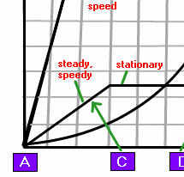
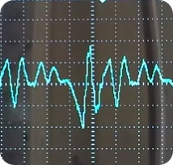
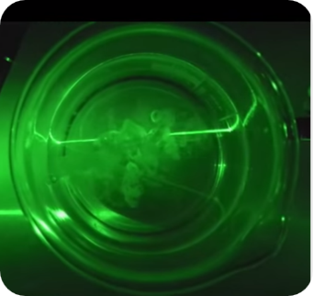
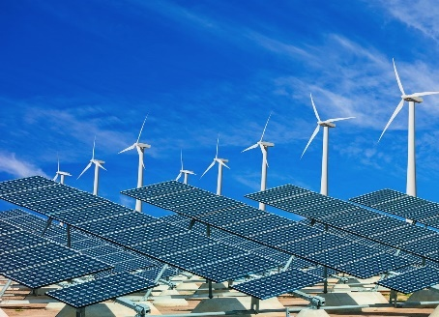
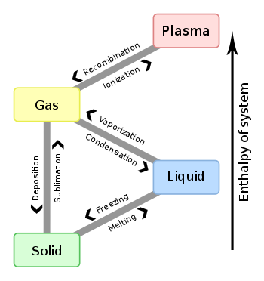
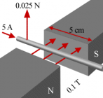
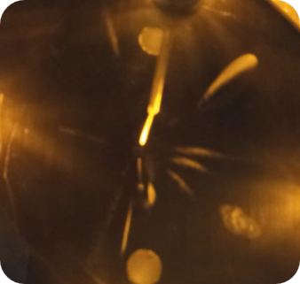
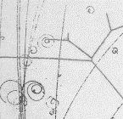
6 Magnetism and Electromagnetism
“Part B - Magnets”
1 Forces and Motion
2 Electricity
3 Waves
4 Energy
5 Solid Liquids Gases
6 Magnetism
7 Radioactivity
8 Astrophysics
iGCSE Edexcel 1-9 – Mr Powell

Slide 2
6 Magnetism – Magnets “Part B”
6.2 know that magnets repel and attract other magnets and attract magnetic substances.
6.3 describe the properties of magnetically hard and soft materials
6.4 understand the term ‘magnetic field line’
6.5 know that magnetism is induced in some materials when they are placed in a magnetic field
6.6 practical: investigate the magnetic field pattern for a permanent bar magnet and that between two bar magnets
6.7 describe how to use two permanent magnets to produce a uniform magnetic field pattern.
6.11P know that there is a force on a charged particle when it moves in a magnetic field as long as its motion is not parallel to the field (Triple)

Slide 3
6 Magnetism – Magnets “Part B”
Key Topic Aims…. (Recall & Apply ideas and formulae)
6.2 know that magnets repel and attract other magnets and attract magnetic substances
6.3 describe the properties of magnetically hard and soft materials
6.4 understand the term ‘magnetic field line’
6.5 know that magnetism is induced in some materials when they are placed in a magnetic field
6.6 practical: investigate the magnetic field pattern for a permanent bar magnet and that between two bar magnets
6.7 describe how to use two permanent magnets to produce a uniform magnetic field pattern.
6.11P know that there is a force on a charged particle when it moves in a magnetic field as long as its motion is not parallel to the field (Triple)
6 Magnetism – Magnets “Part B”
Key Topic Aims…. (Recall & Apply ideas and formulae)
6.2 know that magnets repel and attract other magnets and attract magnetic substances
6.3 describe the properties of magnetically hard and soft materials
6.4 understand the term ‘magnetic field line’
6.5 know that magnetism is induced in some materials when they are placed in a magnetic field
6.6 practical: investigate the magnetic field pattern for a permanent bar magnet and that between two bar magnets
6.7 describe how to use two permanent magnets to produce a uniform magnetic field pattern.
6.11P know that there is a force on a charged particle when it moves in a magnetic field as long as its motion is not parallel to the field (Triple)
6 Magnetism – Magnets “Part B”
Key Topic Aims…. (Recall & Apply ideas and formulae)
6.2 know that magnets repel and attract other magnets and attract magnetic substances
6.3 describe the properties of magnetically hard and soft materials
6.4 understand the term ‘magnetic field line’
6.5 know that magnetism is induced in some materials when they are placed in a magnetic field
6.6 practical: investigate the magnetic field pattern for a permanent bar magnet and that between two bar magnets
6.7 describe how to use two permanent magnets to produce a uniform magnetic field pattern.
6.11P know that there is a force on a charged particle when it moves in a magnetic field as long as its motion is not parallel to the field (Triple)

Slide 4

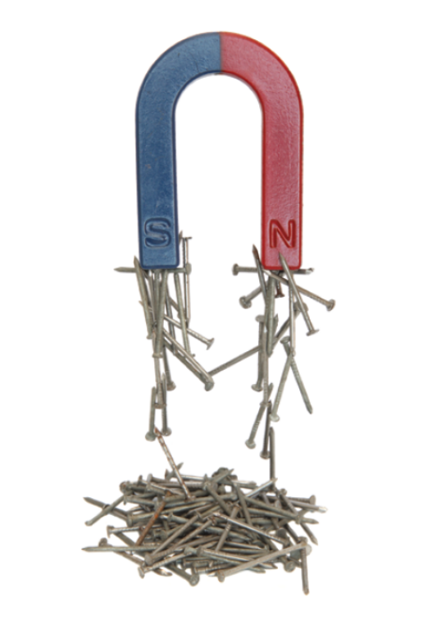
Lesson 1 Magnetism and Magnetic Forces (1.5 hours)
+I can predict the magnetic field lines for NN or SS and plot their fields accurately without help & Explain where Magnetism comes from
I can describe magnetic materials internal domains and how induced magnetism works
7/8
+I can plot AND/OR explain the magnetic field around a bar magnet with some degree of precision.
5/6
I can explain what is meant by the poles of a magnet AND why Birds Fly South in the Winter N -> S (for Mag fields)
4

Slide 5
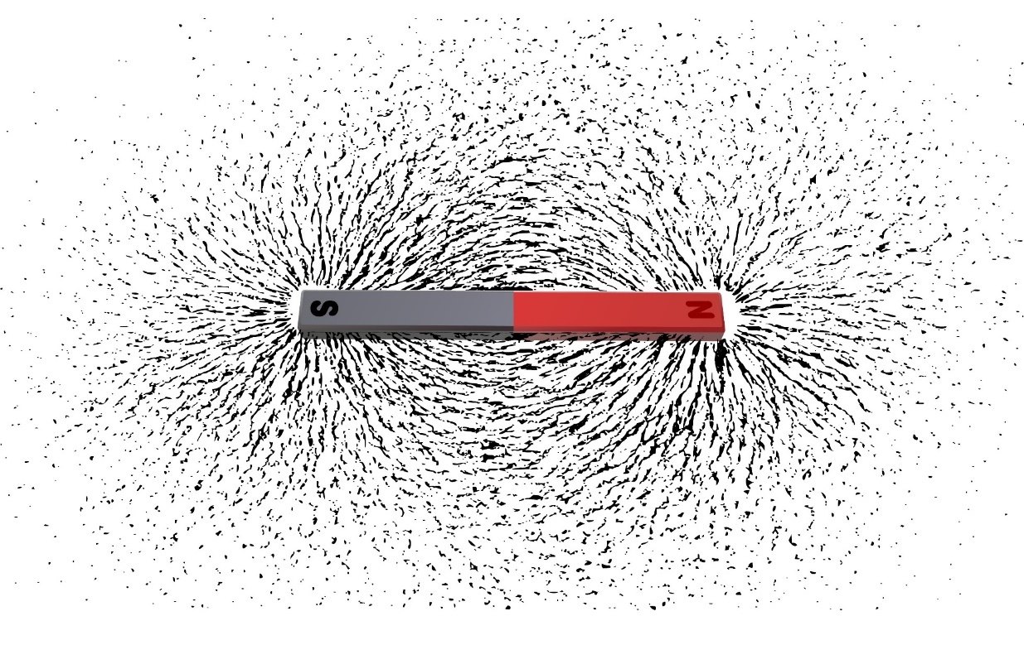
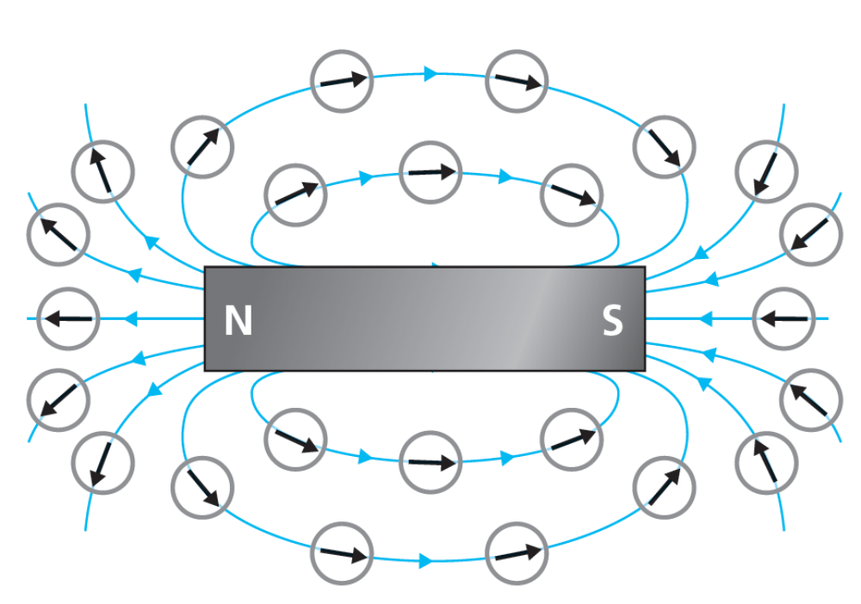
The field around a bar magnet
TASK: Look at the images of practical to investigate a magnetic field.
Discuss with a partner:
how you do each practical in 4 steps.
The variables involved
The results
A benefit and disadvantage of each

Slide 6
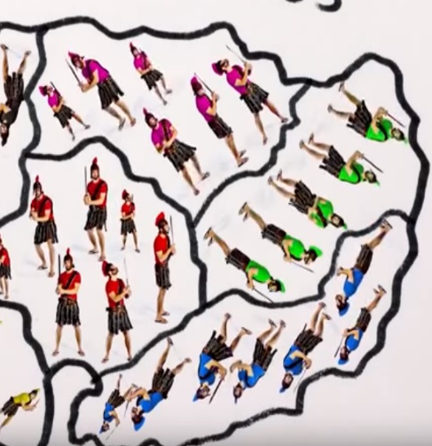
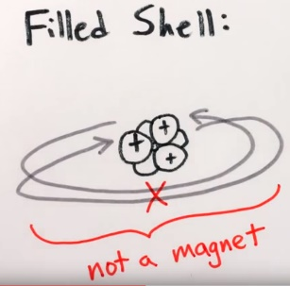
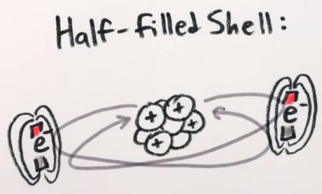
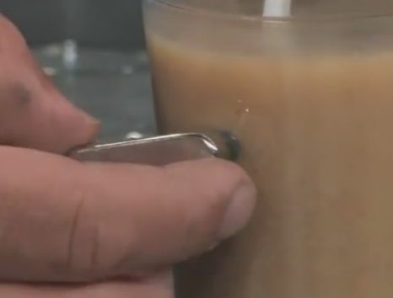

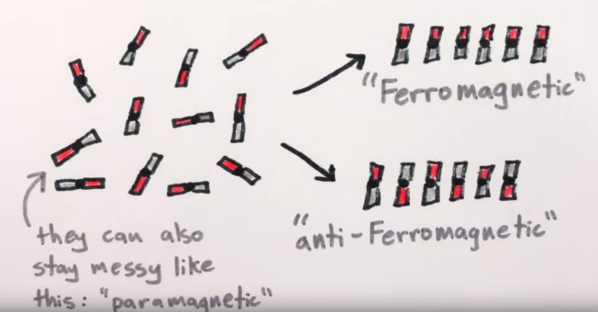
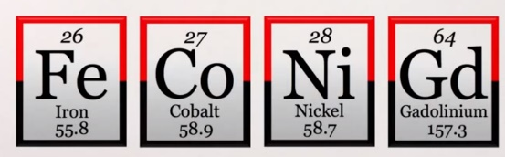
Lesson 1 Magnetism and Magnetic Fields/Forces - Video
3) Why can some Iron not be magnetic?
…………………………………….…...........
…………………………………….…...........
…………………………………….…...........
…………………………………….…...........
1) Where does Magnetism come from, use the shells or energy levels to explain?
…………………………………………………………………………………………..
…………………………………………………………………………………………..
…………………………………………………………………………………………..
4) What is Induced Magnetism (Practical 1), give an example?
…………………………………………………………….
…………………………………………………………….
…………………………………………………………….
………………………………………………………………….........................
2) Why is chromium not Magnetic…
………………………………………………………………………………………….
………………………………………………………………………………………….
………………………………………………………………………………………….
5) Produce a clear accurate plot of a magnetic field from a Bar Magnet (or pair – NN and NS harder) (Practical 2)
https://www.youtube.com/watch?v=hFAOXdXZ5TM
Notes:
Extra help sheet

Slide 7
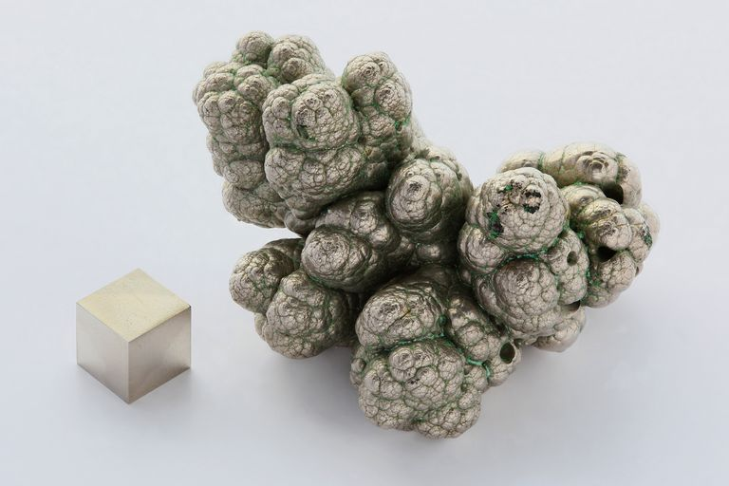
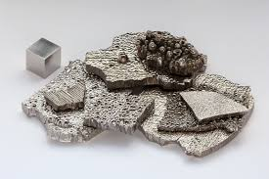
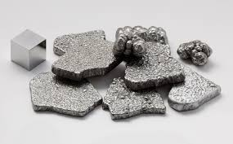
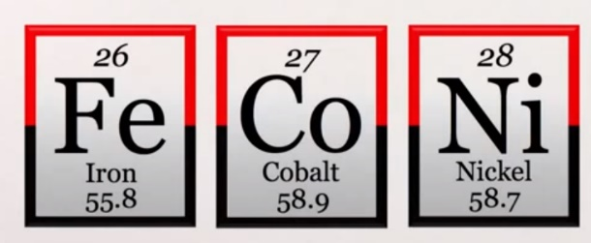
Hard or Soft Magnets – Key idea to write down!
Ni
Iron, nickel and cobalt are the only pure metals that can be turned into a permanent magnet. Steel is an alloy of iron and so can also be made into a magnet.
Metals that are permanently magnetised are described as magnetically hard (often alloys with lots of iron, nickel and cobalt or stainless steel).
If a material is temporarily magnetised it is described as magnetically soft. Pure iron is magnetically soft and can have a weaker magnetic field. Often iron is used in transformers OR electromagnets in car breakers yard. As it is “magnetically soft” so it can demagnetise easily without getting very hot. Alloys of iron are called ferrous and those without iron are called non-ferrous.
Co
Fe

Slide 8
Practical Tasks….
Experiment 1: Induced magnetism
Put a paperclip on the end of a magnet.
Put another paperclip on the end of the paperclip on the magnet. See whether they are attracted.
Repeat this process to see how many paperclips you can make into a line.
Draw an image in the space provided of the domains. (Q4 on worksheet)
Can you explain why this happens (use the video help)?
Experiment 2: Magnetic fields
Place magnets NS-NS and then NS-SN on a piece of paper a few cm apart.
Use a plotting compass to show clearly how the field lines behave inside the area of space between them.
Describe what you see.
Experiment 3: Flakes
Float a cornflake or special-k flake on the surface tension of water in a glass bowl.
Ensure it is floating in the middle then use a Neo-magnet to explore the materials inside the cornflake, what happens?
Try it again with a normal magnet?
Notes:
Practical Order
10 x plotting compass
10x normal magnet
10x iron filings in petri
10 x empty petri
Bowl of cornflakes – to float or special K
Selection of metals named

Slide 9
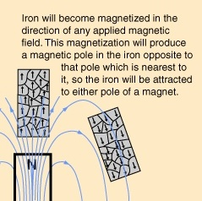
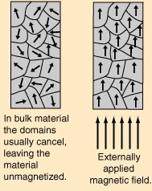
Practical 1: Induced magnetism – 6.3
Task… Note down a clear diagram with domains and 2 key points.
Key Idea:
A material such as iron will temporarily align the domains to become magnetic itself whilst in a field.
This extends the action of the field and enables other objects it touches to be attracted more strongly than through the air alone.

Slide 10
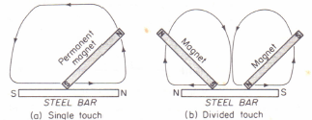
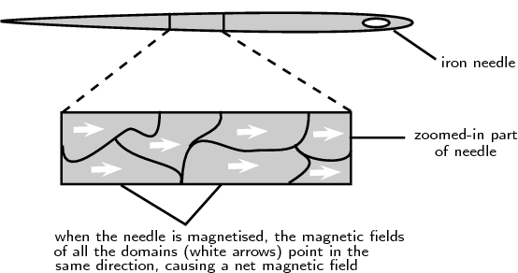
Practical 4: Making a Magnet…. (Extension)

Slide 11
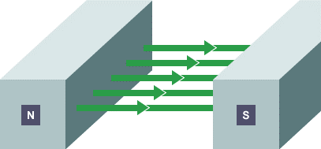
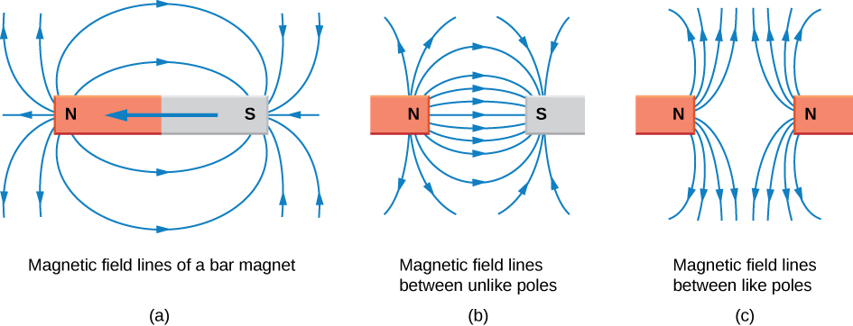
Practical 2: Magnetic field lines have several hard-and-fast rules
Task… Note down the diagrams and 4 key points
A small compass will point in the direction of the field line.
The strength of the field is proportional to the closeness of the lines.
Magnetic field lines can never cross, meaning that the field is unique at any point in space.
Magnetic field lines are continuous, forming closed loops without a beginning or end. They are directed from the north pole to the south pole.

Slide 12
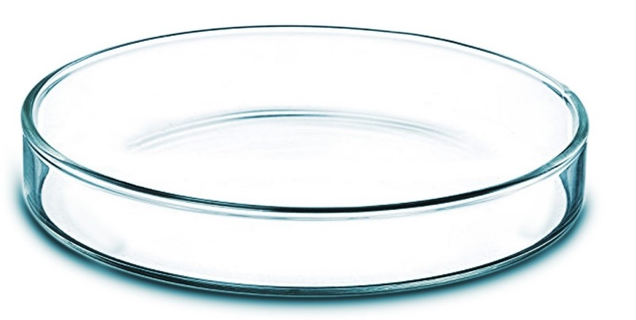

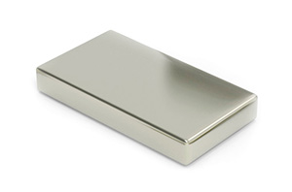
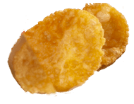
Practical Task 3: Extra detail….
Investigate...
Float a cornflake or special-k flake on the surface tension of water in a glass bowl.
Ensure it is floating in the middle then use a Neo-magnet to explore the materials inside the cornflake, what happens?
Try it again with a normal magnet?
Fact File…. Neodymium iron boron “neo” magnets (NdFeB) magnets offer the strongest fields for size of any permanent magnet material on the market today. The crystal that is formed is very easy to magnetise in one direction and has lots of unpaired electrons in the complex structure (4 in the Nd and 3 in the Fe). This is the root of the magnetism.
NdFeB magnet applications include high performance motors, brushless DC motors, children's toys and sensors

Slide 13
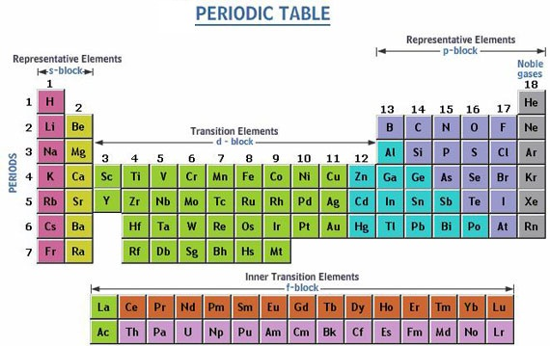
Extension
This table shows the “sub shells” for A-Level
At GCSE you just do 2, 8,8, but they split down even further than this!

Slide 14
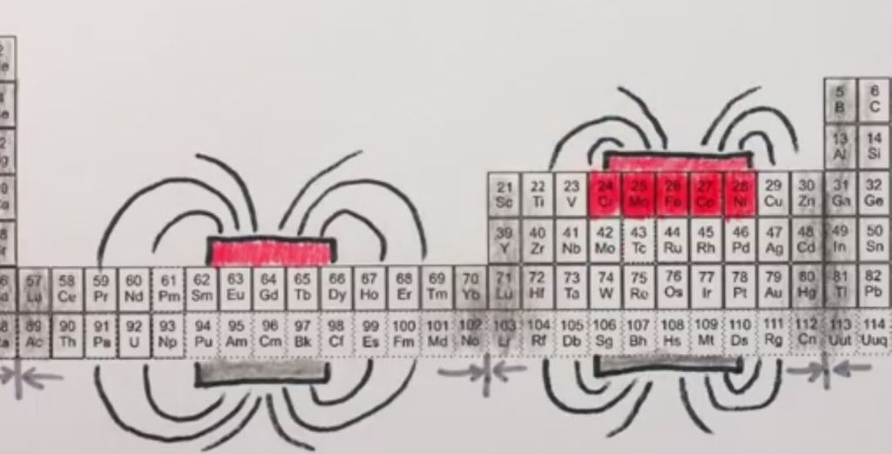
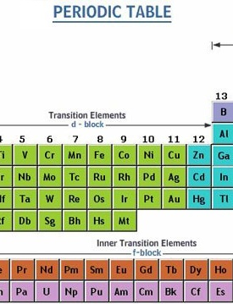
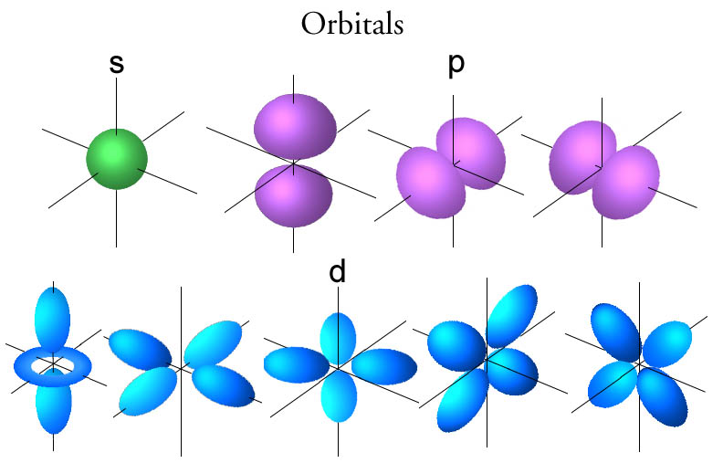
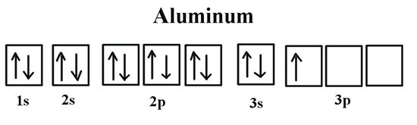
A-Level sub - energy levels - Extension

Slide 15
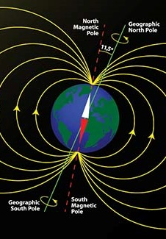
Information about Magnetic Field – to read!
Earth's magnetic field shields us from deadly cosmic radiation, and without it, life as we know it could not exist here.
The motion of liquid iron in the planet's outer core, a phenomenon called a "geodynamo" generates the field with an electrical current.
Our planet accreted from rocky material that surrounded our Sun in its youth, and over time the most-dense stuff, iron, sank inward, creating the layers that we know exist today - core, mantle, and crust.
Currently, the inner core is solid iron, with some other materials that were dragged along down during this layering process. The outer core is a liquid iron alloy, and its motion gives rise to the magnetic field.
Notes:
Accreted – means comes together
Geodynamo – like an electrical motor

Slide 16
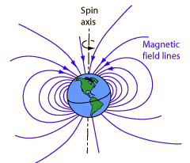
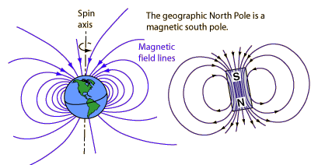
The Earth’s Field
Rock specimens of different age in similar locations have different directions of permanent magnetisation due to a current and field reversal. Evidence for 171 magnetic field reversals during the past 71 million years has been reported.
Although the details of the dynamo effect are not known in detail, the rotation of the Earth plays a part in generating the currents which are presumed to be the source of the magnetic field.
Mariner 2 found that Venus does not have such a magnetic field although its core iron content must be similar to that of the Earth. Venus's rotation period of 243 Earth days is just too slow to produce the dynamo effect.

Slide 17
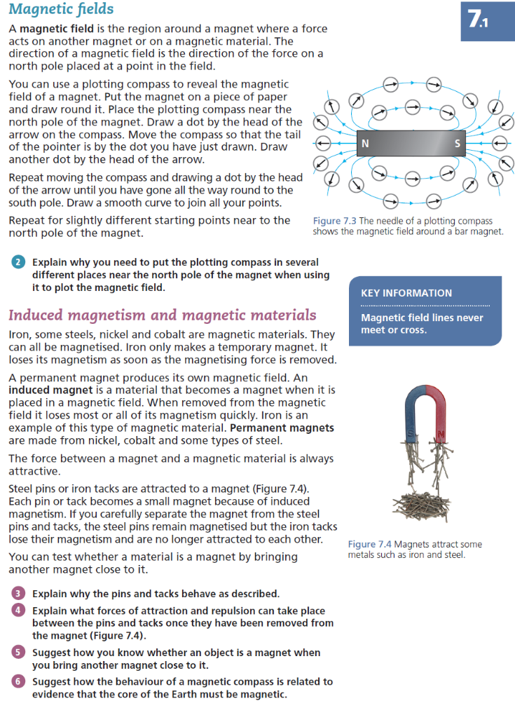
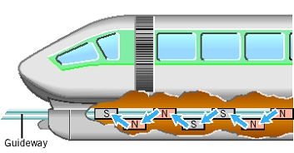
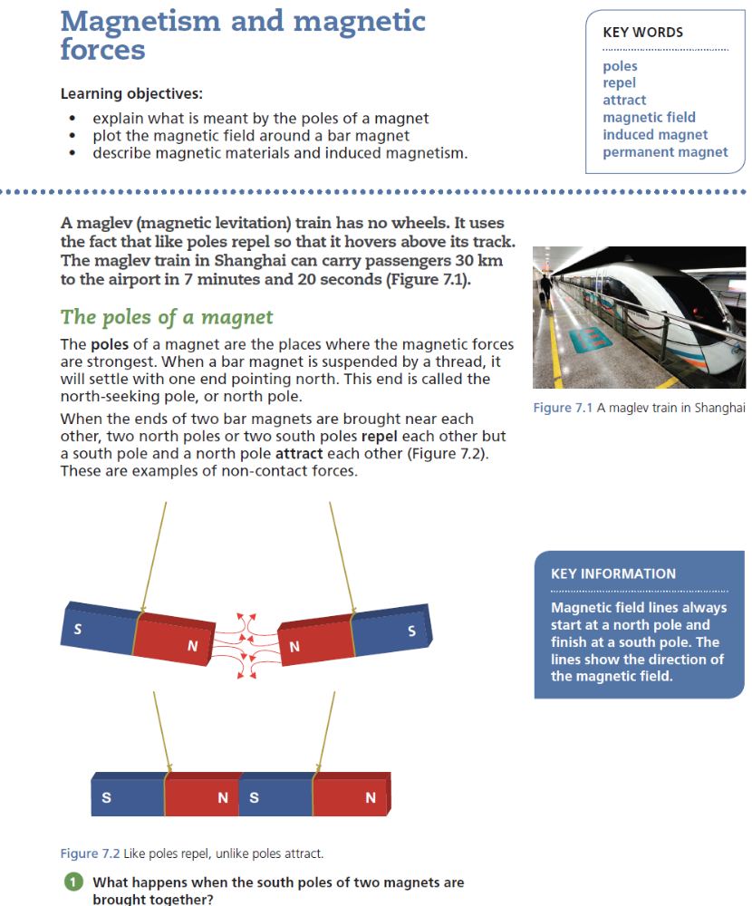
Lesson 1: Magnetic Fields - Questions
Induced magnetism and magnetic materials Iron, some steels, nickel and cobalt are magnetic materials. They can all be magnetised. Iron only makes a temporary magnet. It loses its magnetism as soon as the magnetising force is removed. A permanent magnet produces its own magnetic field. An Induced magnet is a material that becomes a magnet when it is placed in a magnetic field. When removed from the magnetic field it loses most or all of its magnetism quickly. Iron is an example of this type of magnetic material. Permanent magnets are made from nickel, cobalt and some types of steel. The force between a magnet and a magnetic material is always attractive. Steel pins or iron tacks are attracted to a magnet. Each pin or tack becomes a small magnet because of induced magnetism. If you carefully separate the magnet from the steel pins and tacks, the steel pins remain magnetised but the iron tacks lose their magnetism and are no longer attracted to each other. You can test whether a material is a magnet by bringing another magnet close to it.
A maglev (magnetic levitation) train has no wheels. It uses the fact that like poles repel so that it hovers above its track. The maglev train in Shanghai can carry passengers 30 km to the airport in 7 minutes and 20 seconds .
The poles of a magnet The poles of a magnet are the places where the magnetic forces are strongest. When a bar magnet is suspended by a thread, it will settle with one end pointing north. This end is called the north-seeking pole, or north pole. When the ends of two bar magnets are brought near each other, two north poles or two south poles repel each other but a south pole and a north pole attract each other. These are examples of non-contact forces. Magnetic field lines always start at a north pole and finish at a south pole. The lines show the direction of the magnetic field
Questions…
What happens when the south poles of two magnets are brought together?
Explain why you need to put the plotting compass in several different places near the north pole of the magnet when using it to plot the magnetic field.
Explain why the pins and tacks behave as described.
Explain what forces of attraction and repulsion can take place between the pins and tacks once they have been removed from the magnet
Suggest how you know whether an object is a magnet when you bring another magnet close to it.
Suggest how the behaviour of a magnetic compass is related to evidence that the core of the Earth must be magnetic.
A magnetic field is the region around a magnet where a force acts on another magnet or on a magnetic material. The direction of a magnetic field is the direction of the force on a north pole placed at a point in the field. You can use a plotting compass to reveal the magnetic field of a magnet. Put the magnet on a piece of paper and draw round it. Place the plotting compass near the north pole of the magnet. Draw a dot by the head of the arrow on the compass. Move the compass so that the tail of the pointer is by the dot you have just drawn. Draw another dot by the head of the arrow. Repeat moving the compass and drawing a dot by the head of the arrow until you have gone all the way round to the south pole. Draw a smooth curve to join all your points. Repeat for slightly different starting points near to the north pole of the magnet. The needle of a plotting compass shows the magnetic field around a bar magnet.

Slide 18
Lesson 1: Magnetic Fields - Answers
Questions…
What happens when the south poles of two magnets are brought together?
Explain why you need to put the plotting compass in several different places near the north pole of the magnet when using it to plot the magnetic field.
They repel each other.
2 You need to see which way the compass points at different places so that you can plot the field lines and see the direction and positions of each line.

Slide 19
Lesson 1: Magnetic Fields - Answers
Questions…
Explain why the pins and tacks behave as described.
Explain what forces of attraction and repulsion can take place between the pins and tacks once they have been removed from the magnet
Suggest how you know whether an object is a magnet when you bring another magnet close to it.
Suggest how the behaviour of a magnetic compass is related to evidence that the core of the Earth must be magnetic.
Induced magnetism and magnetic materials Iron, some steels, nickel and cobalt are magnetic materials. They can all be magnetised. Iron only makes a temporary magnet. It loses its magnetism as soon as the magnetising force is removed. A permanent magnet produces its own magnetic field. An Induced magnet is a material that becomes a magnet when it is placed in a magnetic field. When removed from the magnetic field it loses most or all of its magnetism quickly. Iron is an example of this type of magnetic material. Permanent magnets are made from nickel, cobalt and some types of steel. The force between a magnet and a magnetic material is always attractive.
3 When the pins and tacks are inside a magnetic field they become magnets themselves. When they are removed from the magnetic field, the tacks lose their magnetism straight away because they are made of iron but the pins remain magnetised because they are made from steel. (An alloy of carbon, iron and other trace elements)
4 The iron tacks become magnetised so they are magnetic materials whereas the pins remain permanently magnetised. Therefore, the tacks will have no effect on other tacks; the tacks and pins will always attract each other; the pins will either attract or repel other pins depending on which way round they are.
5 A magnet will be repelled by the same poles of another magnet. A material like iron can only be attracted by another magnet.
6 The magnetic compass experiences forces of attraction and repulsion from the Earth which would suggest that the core of the Earth is magnetic.

Slide 20
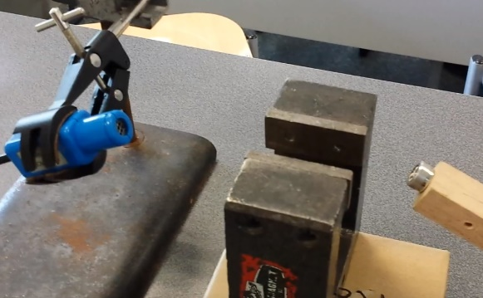





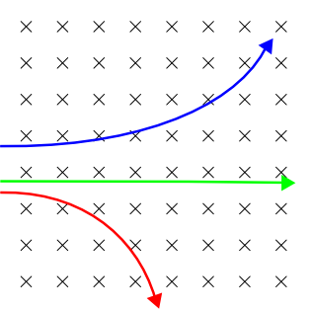
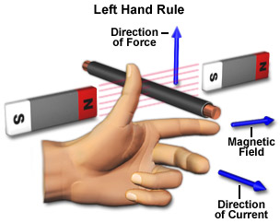
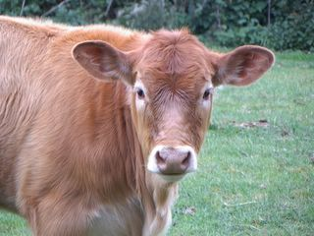
6.11P There is a force on a charged particle when it moves in a magnetic field as long as its motion is not parallel to the field.
https://www.youtube.com/watch?v=-jAOCHFsLeA
Charged particles act as if they are a flow of current in a magnetic field (+ to – ) and field N->S into the page. If they enter the field at 90 degrees the field lines you get maximum effect. Of they flow with the field lines you get 0 effect.
S
B
e⁻
= field out of the page
N
α
F
x = magnetic field into the page
γ
B
I
e

Slide 21
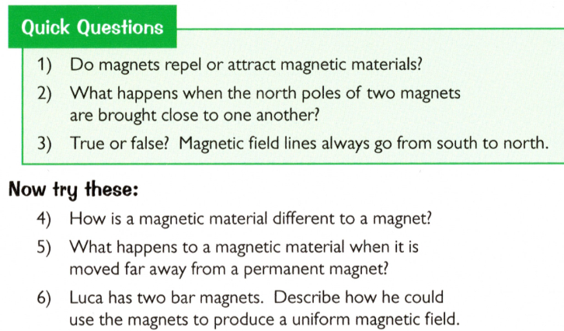
Spaced Learning Review Question
Task 1… Answer the questions on your own – write a clear answer and number in your book. Get as far as you can in the time you have….
Magnets and Fields

Slide 22
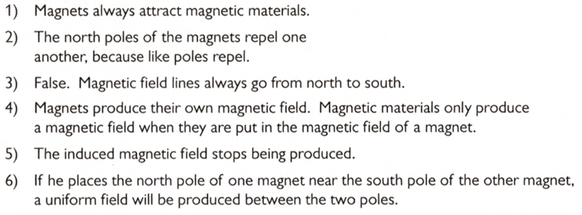
Spaced Learning Review Answers
Task 2… Mark your work in green pen, you can judge how you did, put a clear total at the bottom and put one clear comment on what you must improve on.
Magnets and Fields

